Slide 1
Smart Systems
Tussentijdse presentatie Poembak Delco

Slide 2
opdracht

Slide 3

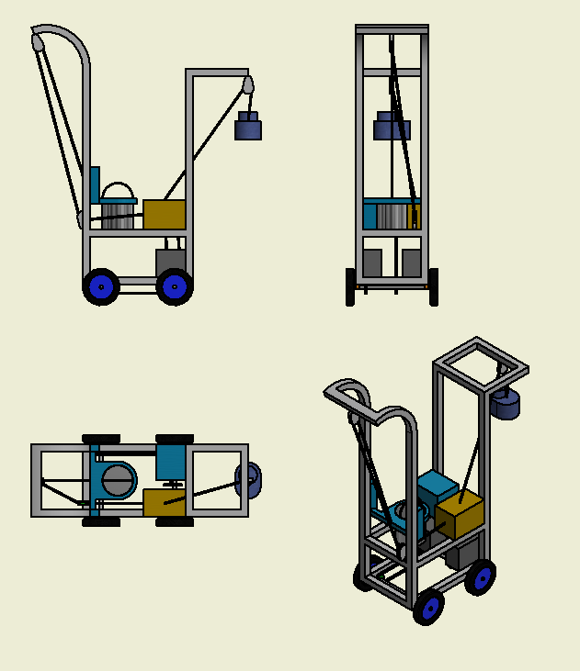
Overzetten van water
Autonomous design
Open bucket
10L in 5 minuten

Slide 4
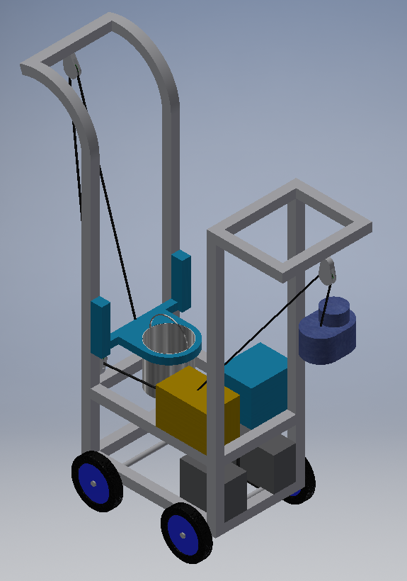
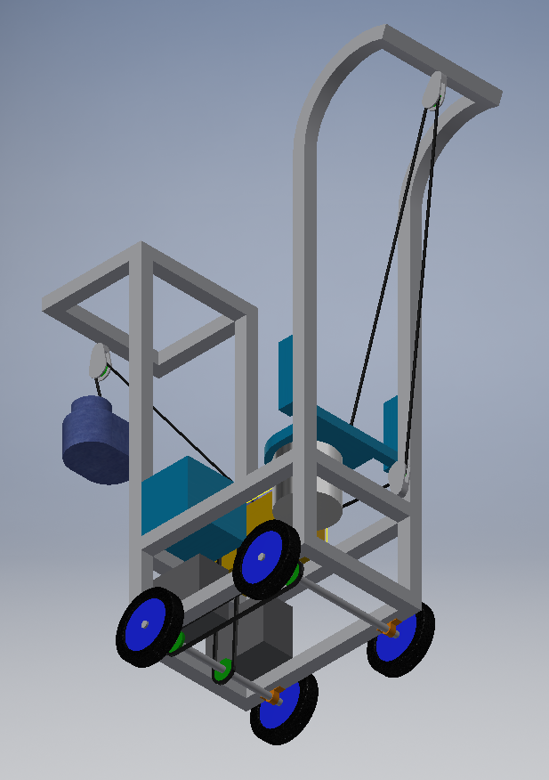
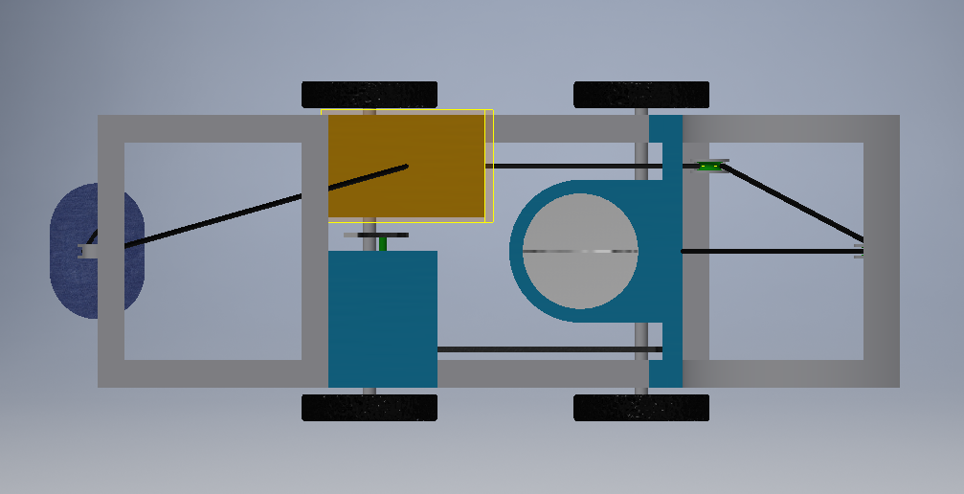
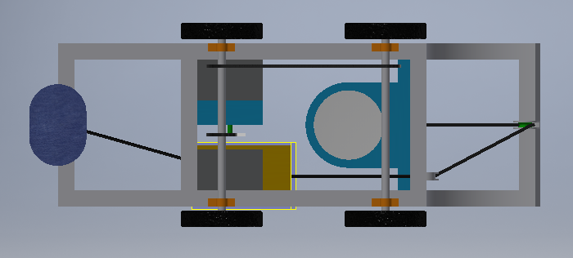
Designs

Slide 5
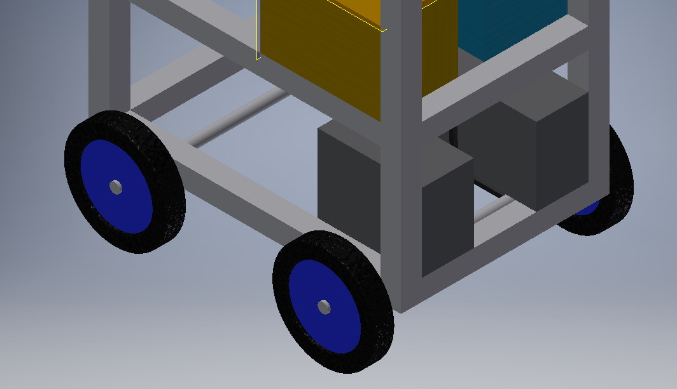
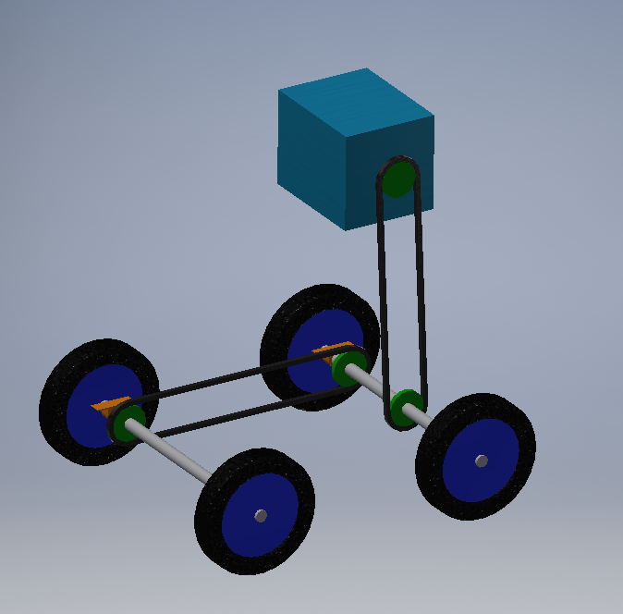
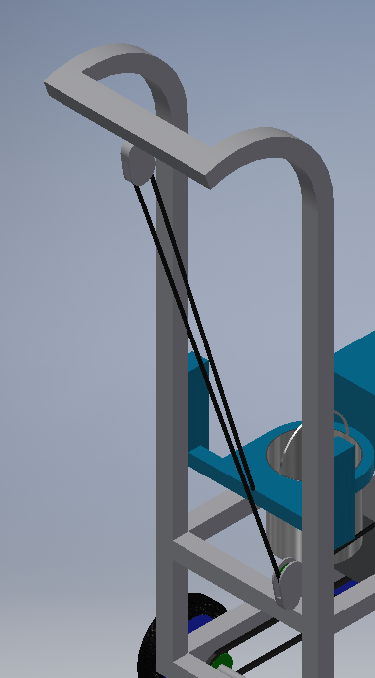
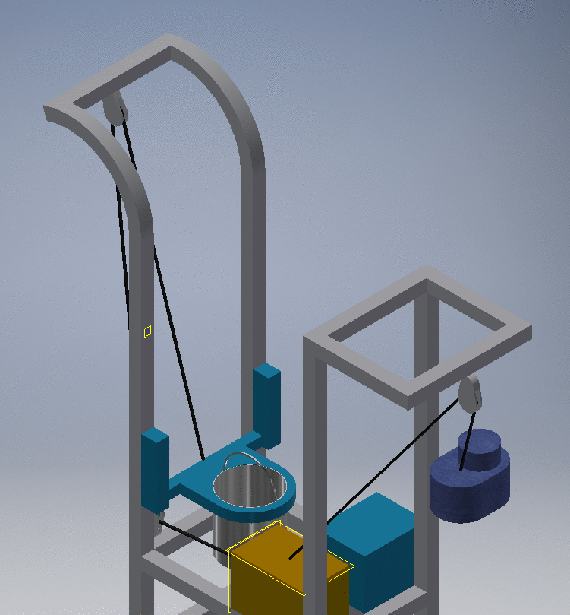
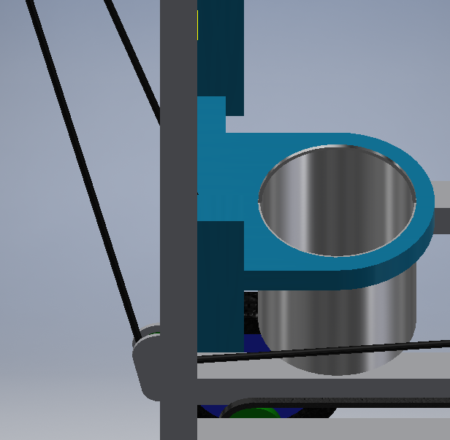
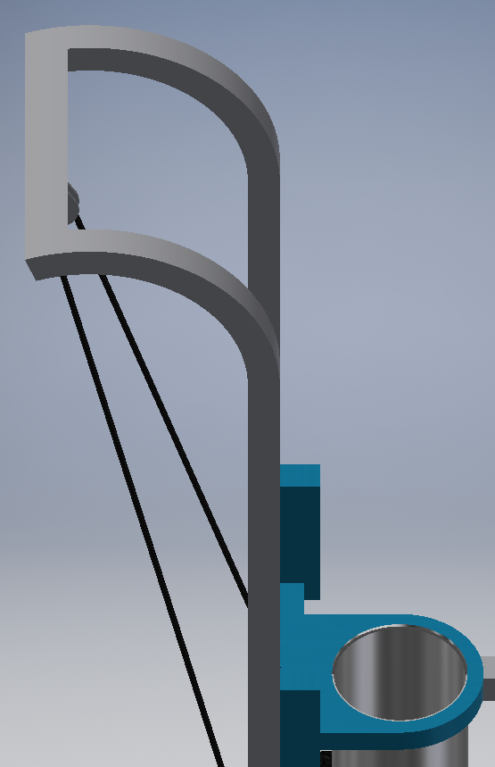

Slide 6
Meet the team

Slide 7
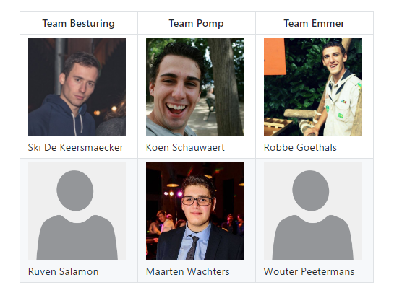

Slide 8
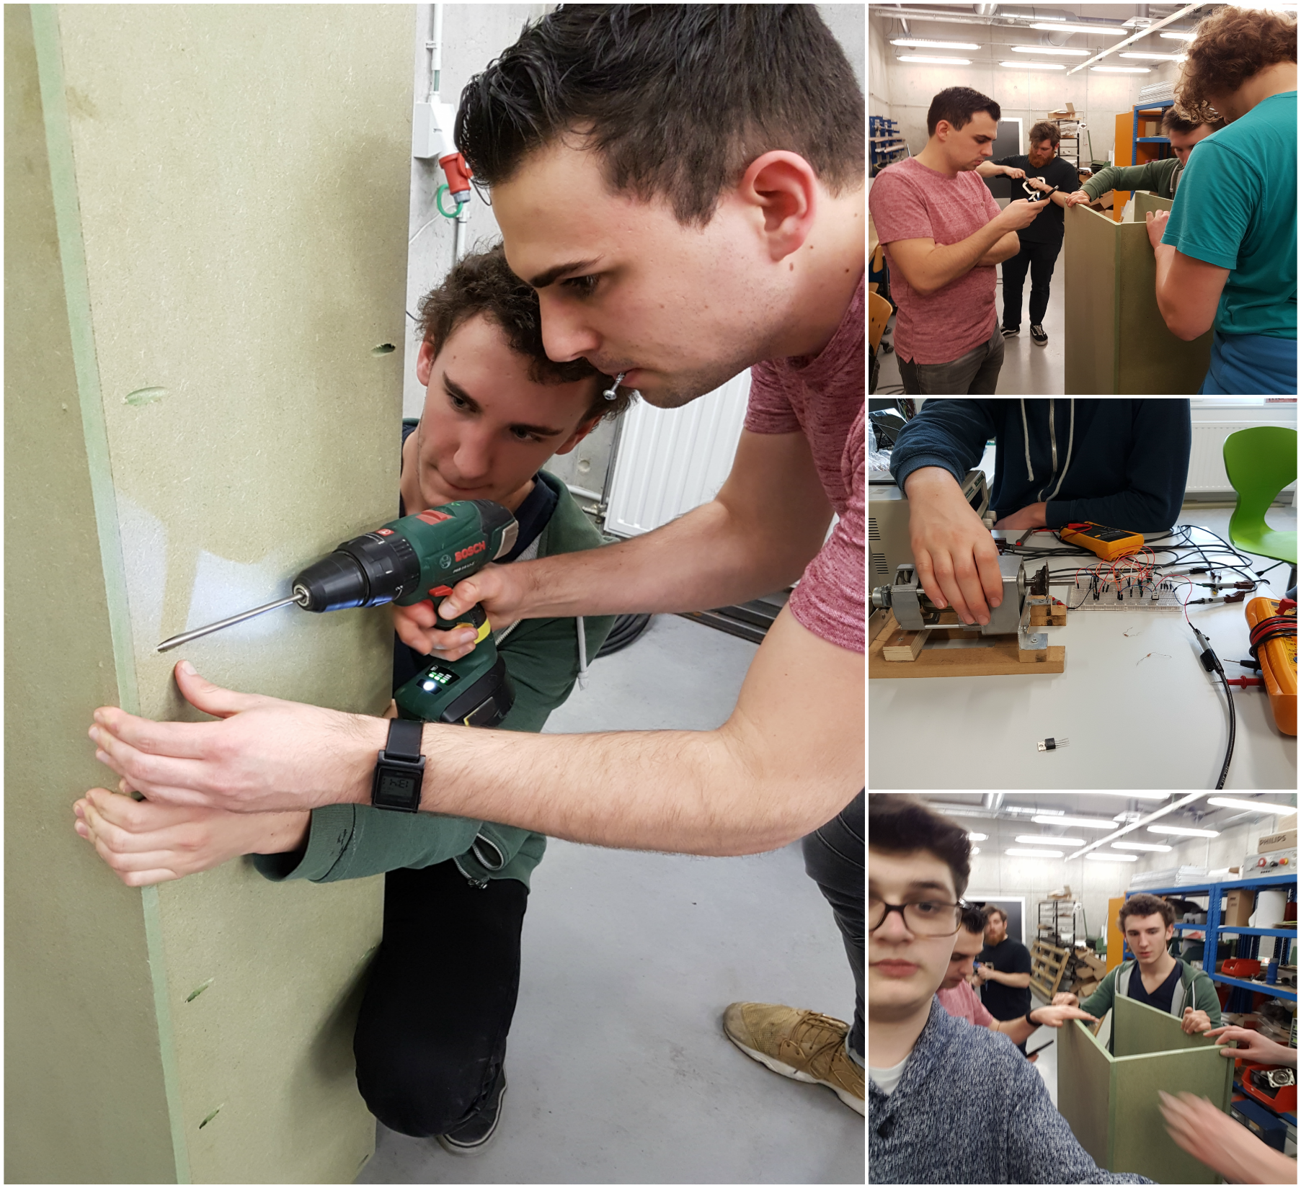

Slide 9
Progress
What have we been up to?

Slide 10
Checklist
Sponsoring CCM
Maken motorcontroller
Frame
Sturing motor
Sensoren inlezen
Doorsturen van data

Slide 11
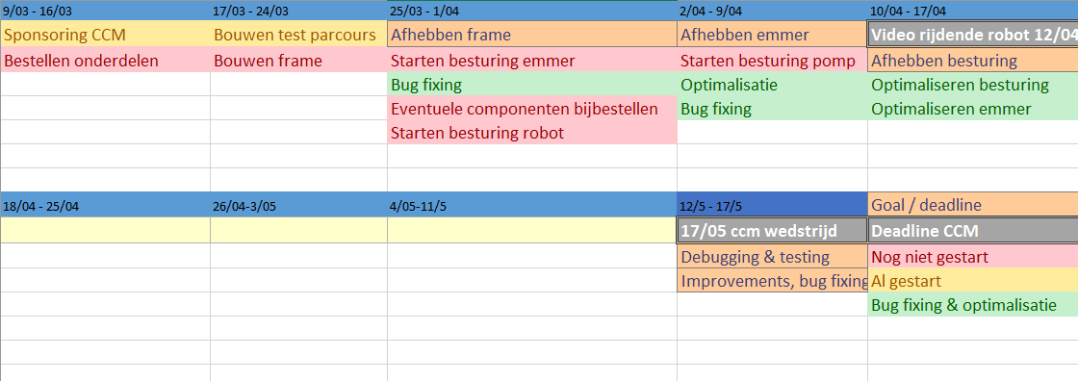
Planning

Slide 12
Documentatie

Slide 13
Links
Github: https://github.com/ccmteamap/robot
Wiki: https://github.com/ccmteamap/robot/wiki
Info CCM: http://www.ccm.nl/nl/trofee/
Issues & sprints: https://github.com/ccmteamap/robot/issues
Online roadmap: https://app.ganttpro.com/#!/app/home

